Slide 1

Web Scraping to gain company insights
Task 1
By: Subhransu Sekhar Mallick

Slide 2
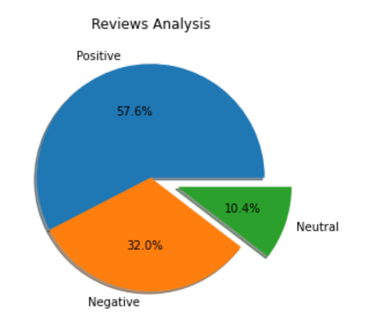
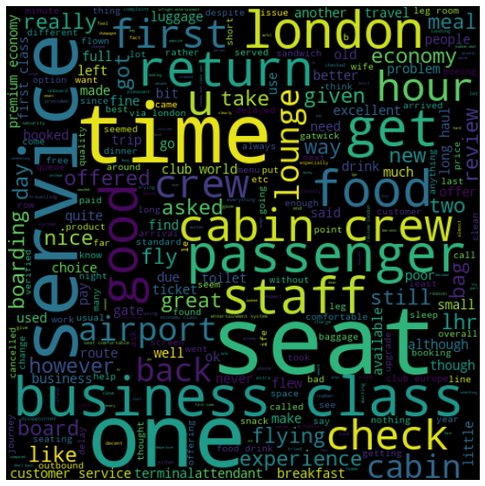
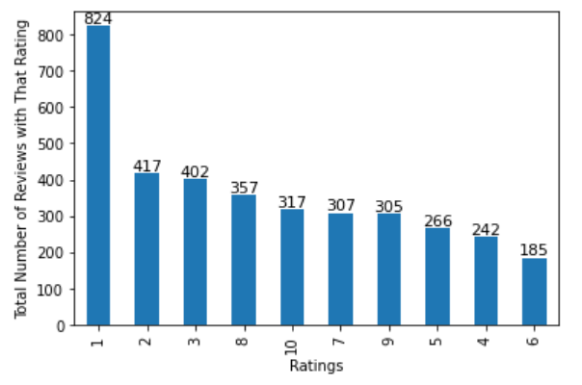
Customer Reviews Insights:
Reviews Considered
3620
WORD CLOUD OF KEYWORDS USED IN REVIEWS
Positive
2085
SENTIMENT ANALYSIS
Neutral
1157
Negative
378
TOTAL COUNTS FOR EACH RATINGS
OUT OF 10
Average overall rating
4.77

